Slide 1
Thread Pool
ThreadGroup

Slide 2
Thread Pool: Executor ; ExecutorService
can be used to execute tasks efficiently
Starting a new thread for each task could limit throughput and cause poor performance
Executor and ExecutorService interfaces

Slide 3
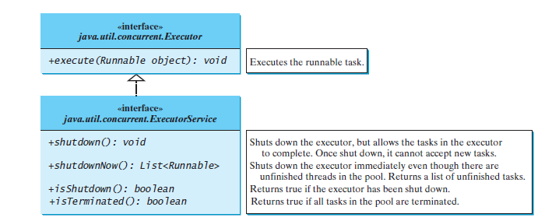

Slide 4
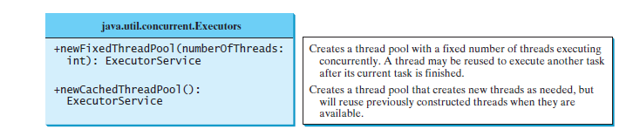
Thread Pool :Executors class

